Slide 1


Flutter CI/CD basics with GitHub Actions
Daniil Shumko
@daniil_shumko
hi@daniilshumko.com

Slide 2
What is GitHub Actions? 🧐
CI/CD service
Makes it easy to automate all your software workflows
Access to Linux, macOS, Windows, ARM and containers
Over 7.4k actions on the marketplace
YAML only workflow configuration
Free for public repositories
Very generous free plan
Fairly new service

Slide 3
Any other options? 🤔
Bitrise
Mobile-first features that help you build, test and deploy faster and more efficiently
UI & YAML support
Very good free plan
Codemagic
Started as a Flutter-first CI/CD service and moving towards Mobile-first.
UI & YAML support
Good free plan

Slide 4
Why use GitHub Actions? ✅
Free for public repositories & very generous free plan
Free extra build minutes with Pro, Team and Enterprise accounts
Your code and CI/CD configuration lives all in one repo
Integrates nicely with GitHub pull request rules, issues and projects
Used by big names
Lots of open source 3rd party actions

Slide 5
Prerequisites 💪
Signing keys/certificates
https://flutter.dev/docs/deployment/android
https://flutter.dev/docs/deployment/ios
ExportOptions.plist file
How to on repo
Google Service account
https://docs.fastlane.tools/actions/supply/#setup
Apple credentials and app-specific password

Slide 6

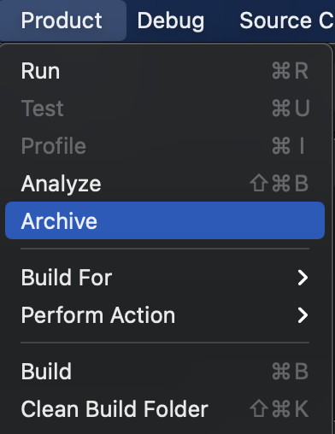
Prerequisites 💪💪 - ExportOptions.plist
Open the iOS project in Xcode
Set the target to ‘Any iOS Device…’
Archive the app

Slide 7
Prerequisites 💪💪 - ExportOptions.plist
4. On the Archives window click on ‘Distribute App’

Slide 8
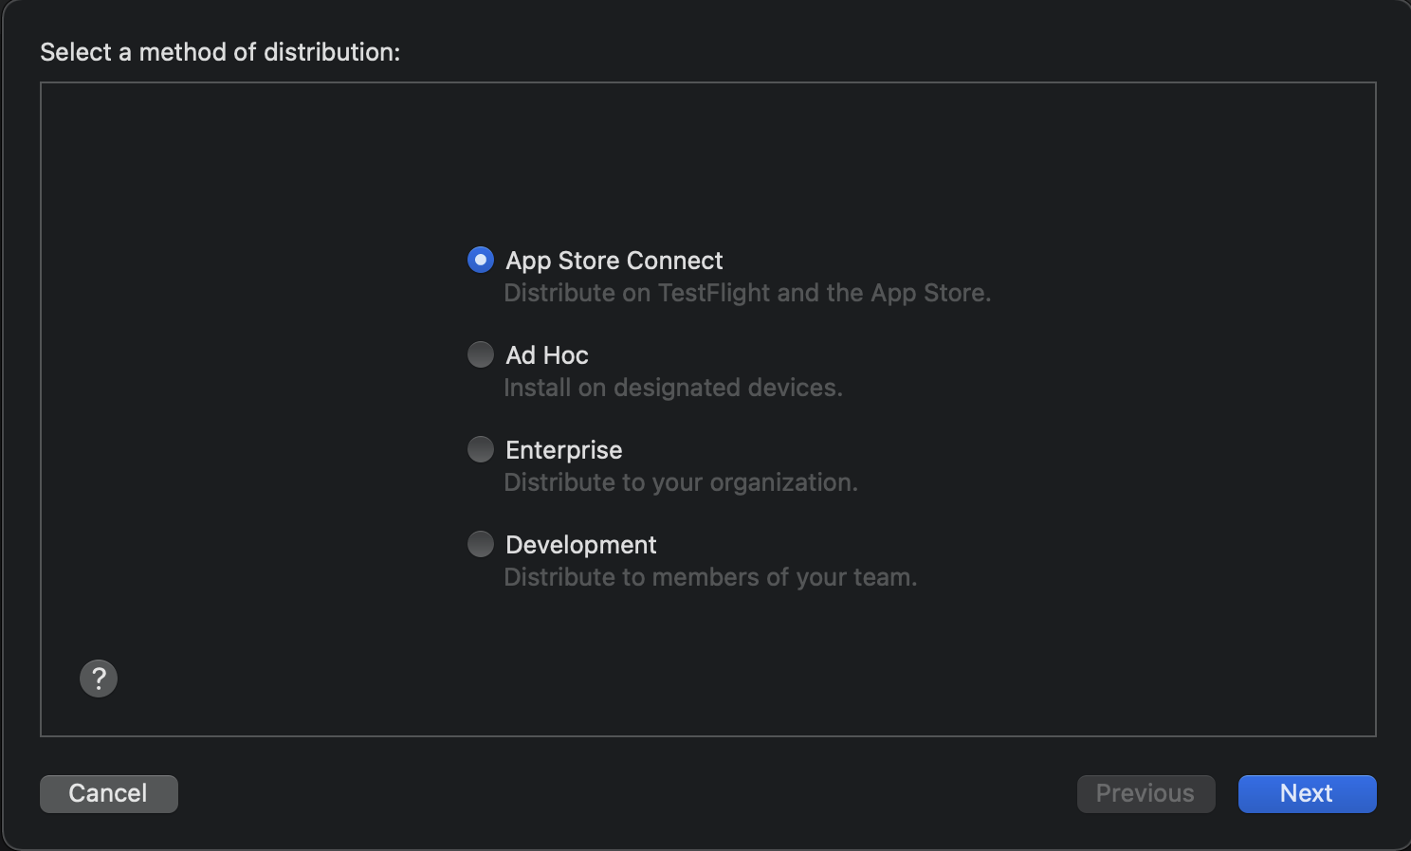
Prerequisites 💪💪 - ExportOptions.plist
5. Select your desired destination and click ‘Next’

Slide 9
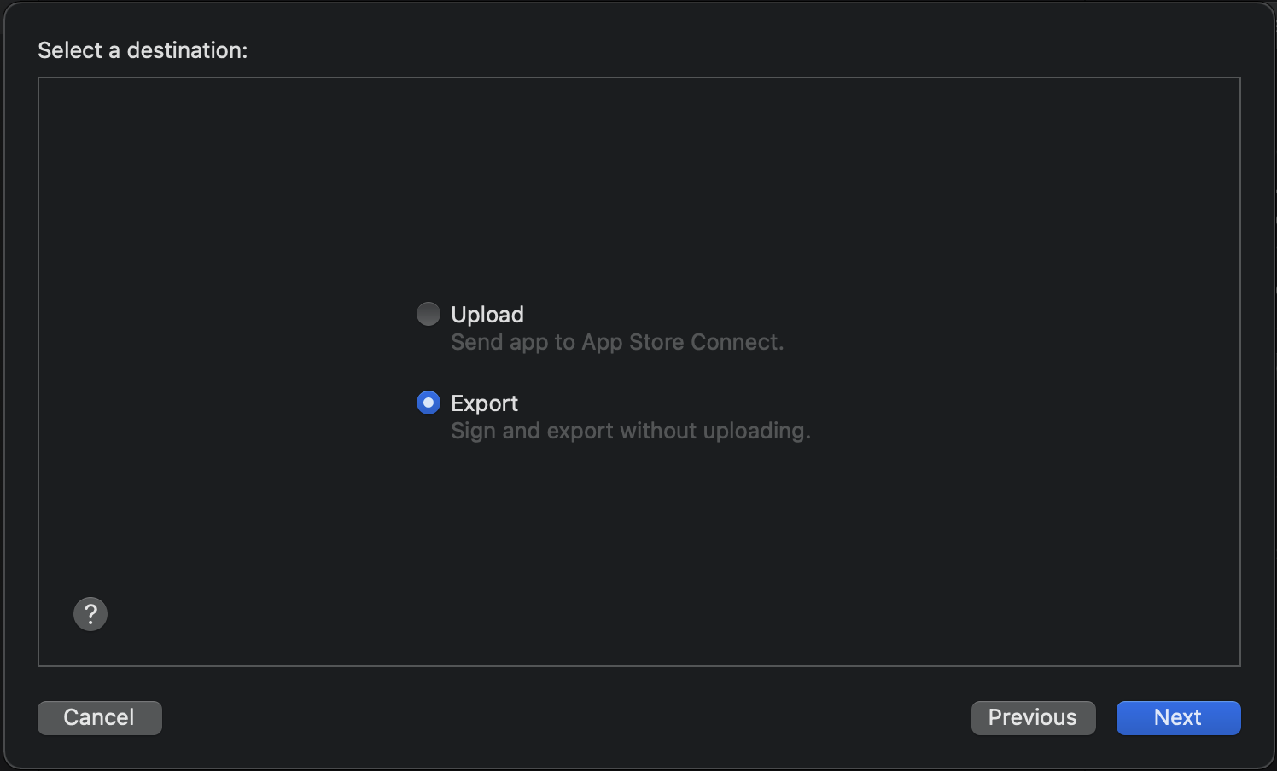
Prerequisites 💪💪 - ExportOptions.plist
6. If your destination is ‘App Store Connect’ choose ‘Export’ and click ‘Next’

Slide 10
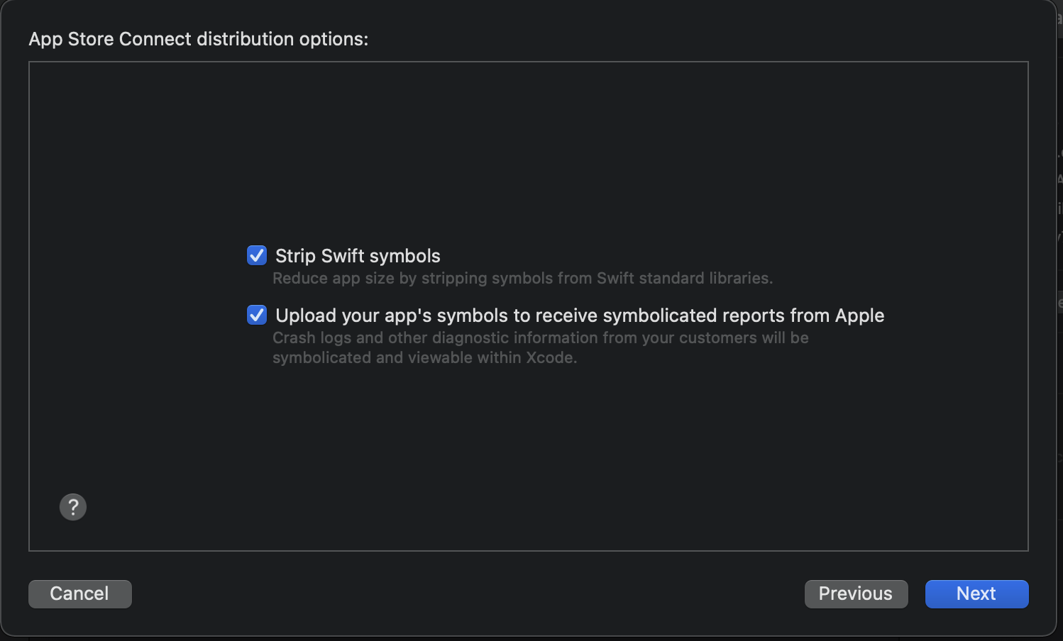
Prerequisites 💪💪 - ExportOptions.plist
7. ‘Next’

Slide 11
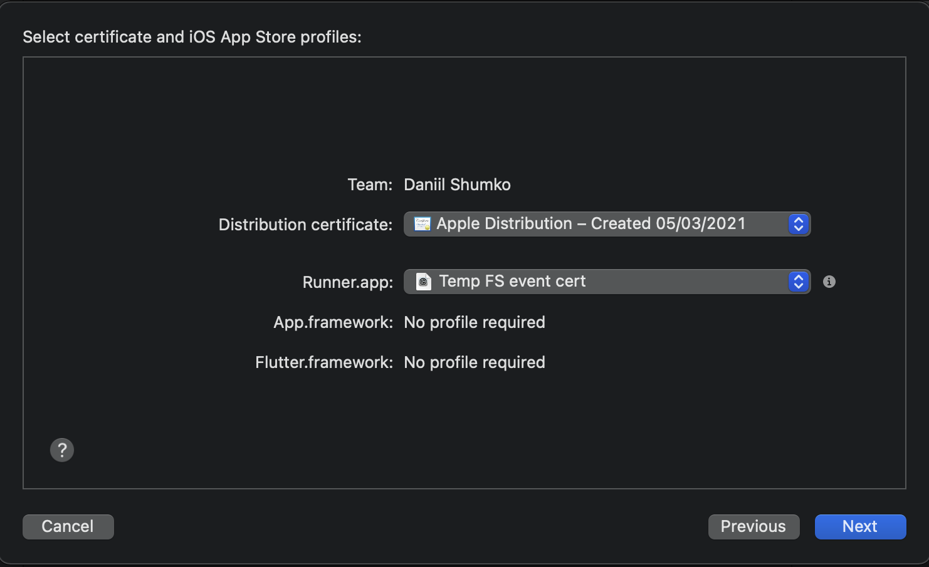
Prerequisites 💪💪 - ExportOptions.plist
8. Choose correct distribution certificate and provisioning profile, click ‘Next’

Slide 12
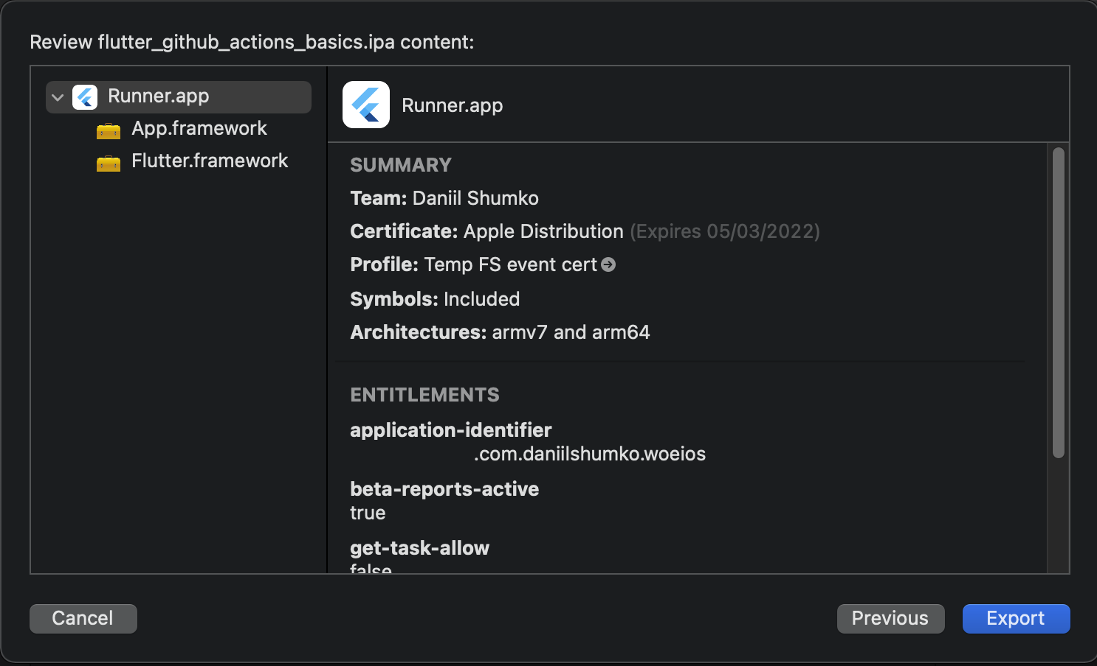
Prerequisites 💪💪 - ExportOptions.plist
9. Click ‘Export’

Slide 13
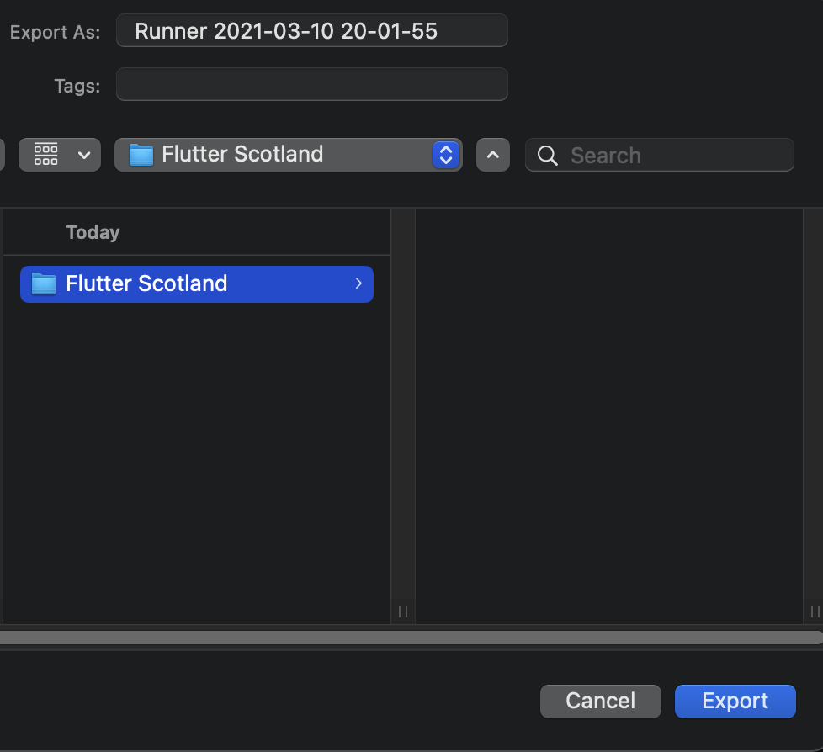
Prerequisites 💪💪 - ExportOptions.plist
10. Choose your preferred location and click ‘Export’

Slide 14
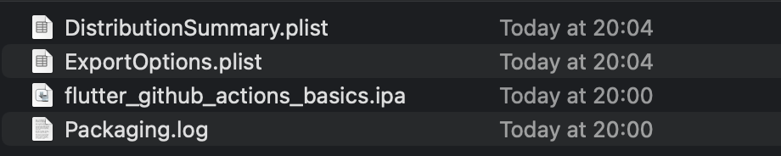
Prerequisites 💪💪 - ExportOptions.plist
Victory 🎉
Add the ExportOptions.plist file to the ios/ folder of your Flutter project

Slide 15
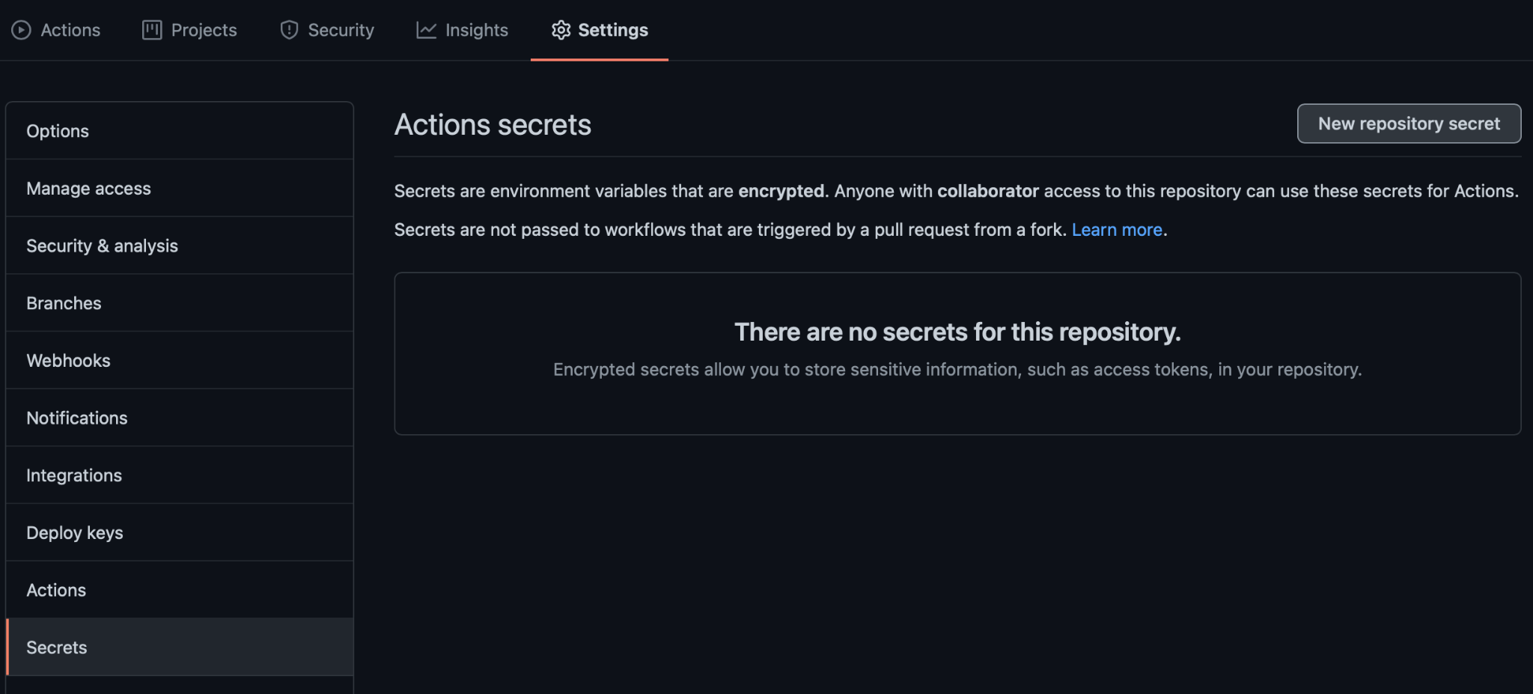
Prerequisites 💪💪💪
Add your secrets to your GitHub repo

Slide 16
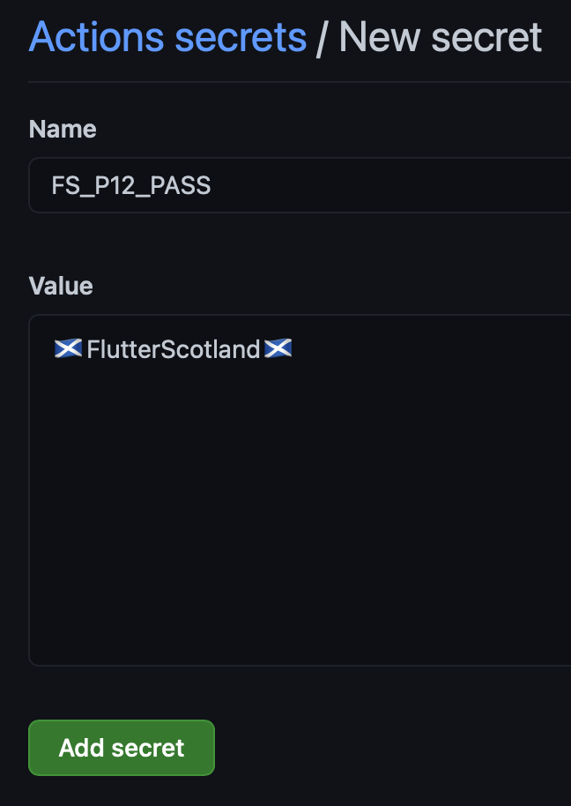
Prerequisites 💪💪💪
Add your secrets to your GitHub repo

Slide 17
Prerequisites 💪💪💪💪
Add your .p12, .mobileprovision, key.properties & key.jks files to the GitHub Secrets.
Using Base64 encoded string:
openssl base64 -in <input.file> > <output.txt> -A

Slide 18
Workflow steps
Run tests and code analysis
Set up code signing on VM
Set up Flutter on VM
Build the app
Upload artifacts
Deploy artifacts

Slide 19
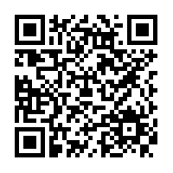
Q&A - ask me anything :)
Source code at:
https://github.com/daniil-shumko/flutter_github_actions_basics

